Slide 1
Channel Access Security
Kay Kasemir
Jan. 2022
Material copied from IOC Application Developers Guide by Marty Kraimer, Janet Anderson, Andrew Johnson (APS) and others

Slide 2
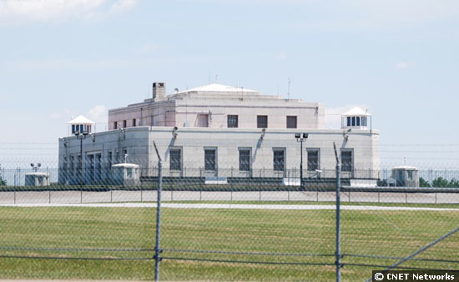
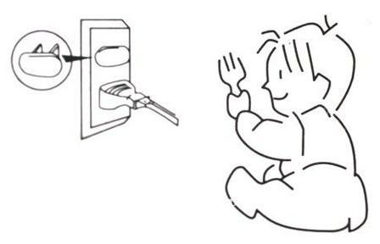
“Security”?
Not like this
  Fend off malicious hackers, evildoers, long-haired troublemakers
More like this
  Prevent casual users from making mistakes
  Help operators follow procedures
http://asset3.cbsistatic.com/cnwk.1d/i/ne/p/2008/FortKnox_550x338.jpg
http://i01.i.aliimg.com/img/pb/216/247/491/491247216_377.jpg

Slide 3
Function and Scope
Control reading and/or writing of EPICS records via Channel Access
  Almost never used to limit reading
Criteria:
Who, which user?
  Control system engineer may always access everything
  Beam Line Staff may always access most things
  Beam Line Users cannot write certain things
From where, which machine?
  Full access from Beam Line Control Room OPIs
  No write access from anywhere else
When, in which system state?
  Read-only while experiment is running, while automation is enabled, …
  Writable when experiment idle, manual control enabled, …

Slide 4
Limitations
… Via Channel Access
  Nothing is encrypted
  IOC console (dbpf, …) not affected
Who?
  $USER
From Where?
  Host name, easy to fake

Slide 5
Specification Summary
A record belongs to one access security group (ASG)
CA Security config file defines ASG:
  Multiple rules (read or write)
    Groups of users (which user)
    Groups of hostnames (which machine)
    Optionally qualified by the value of PVs (which state)
  Rules give statements like:
      Operators may write any property of PVs in this group from any OPI in the control room in any system state
      Maintenance personnel may write values of PVs in this group from any maintenance OPI when the system state is maintenance

Slide 6
EPICS DB
Record
  Assigned to access security group
  field(ASG, "LIMITED")
  Default ASG is DEFAULT
Fields have Access Security Level property
  Most in ASL1
  Some are ASL0
  Nobody can remember. See *.dbd

Slide 7
Access Security File
UAG(<name>) { <user> [, <user> ...] }
...
HAG(<name>) { <host> [, <host> ...] }
...
ASG(<name>) {
[INP<index>(<pvname>) ...]
RULE(<level>,NONE |READ|WRITE [,NOTRAPWRITE | TRAPWRITE] ) {
[UAG(<name> [,<name> ...])]
[HAG(<name> [,<name> ...])]
CALC(<calculation>)
}
...
}
...

Slide 8
RULE(<level>, <what>,[<trap option>])
<level> is 0 or 1.
  The dbd file assigns each field an access security level. Level 1 fields are typically related to record behavior and configuration. Level 0 fields are related to value.
    Example: For the AI record, VAL is level 0, all the rest are level 1
  Rules for level 1 also grant access to level 0
  Example: Everybody can write VAL (level 0), but restrict other fields:
  ASG(WRITE_SOME)
  {
  RULE(1, READ)
  RULE(0, WRITE)
  RULE(1, WRITE)
  {
  UAG(x_users)
  HAG(x_hosts)
  }
  }
<what> is NONE, READ, or WRITE
  Plus an optional TRAPWRITE, which will cause invocation of a trap write listener, i.e. custom C code that may be added to the IOC. This can be used to log write access by user and host, it doesn't otherwise affect access security.

Slide 9
Default Implicit Behavior
If no access security file is loaded, all users from anywhere may read and write all fields of all records anytime
The previously mentioned DEFAULT ASG has no effect

Slide 10
Equivalent Explicit Default Configuration
Create file simple.acf with the following content:
ASG(DEFAULT)
{
RULE(1, READ)
RULE(1, WRITE)
}
Add the following line to your st.cmd:
asSetFilename("path_to_the_file/simple.acf")
asSetSubstitutions("P=prefix,N=14")
Result:
  Since, by default, records belong to the ASG named DEFAULT
    full read/write to all records is allowed
  Functionally equivalent to doing nothing
  But now, the asprules and asdbdump commands show something
Caveat:
  If the AS config file does not exist or contains a syntax error,
  all access is prohibited!
  Use the ascheck utility on the host before loading a file into the IOC

Slide 11
Read-Only
Group that allows read, but no write:
ASG(READONLY)
{
RULE(1, READ)
# Nothing in here about WRITE…
}
To have any effect, set the ASG field of at least one record to READONLY
  You can change ASG fields at runtime
  … via Channel Access, unless AS prohibits it…
caput will show that the old and new values stay the same
Display tools (edm, CSS BOY, ..) will indicate read-only access via cursor or disabled widgets

Slide 12
Limit Write to Users and Hosts
Limit write access to
  members of a user access group UAG
  while on a computer in the host access group HAG
  UAG(x_users) { training }
  HAG(x_hosts) { training-VirtualBox }
  ASG(X_TEAM)
  {
  RULE(1, READ)
  RULE(1, WRITE)
  {
  UAG(x_users)
  HAG(x_hosts)
  }
  }
Caveats:
  The CA client library sends the user and host names to the server. Especially the host name can be tricky:
  It's not the client's IP address
  It's the result of the hostname command, which might be myhost or some.site.myhost, might differ from DNS name
  The casr command on the IOC can sometimes help to show who and from where is connecting via CA, and the asdbdump command shows who they pretend to be

Slide 13
Limit Access by System State
Limit write access to times where some set of variables meets some criteria
  ASG(MODE)
  {
  INPA(accelerator_mode) # accelerator_mode is normal pv
  RULE(1, READ)
  RULE(1, WRITE)
  {
  CALC(A < 5)
  }
  }
This is based on the same code as the CALC record
  PVs may be assigned to inputs A through L
  The computation should result in 0 or 1, the latter allowing access

Slide 14
SNS Beamline Example
DEFAULT
  Anybody can read
  Special list of experts can always write
  Normal users cannot write in certain modes
ALWAYS
  Anybody can always read and write
  Use for “STOP”, “ABORT” type PVs
EXPERT
  Anybody can read
  Only special list of experts can write

Slide 15
Additional Security Measures
Place IOCs in private network
  No ‘telnet’ to their console
  No Channel Access from malicious clients
  Outside access (ssh, VNC, …) controlled the usual way
Add Channel Access Gateway to other networks
  Gateway also has access security
  Make it read-only

Slide 16

And that's all
I have to say about that!

